Slide 1



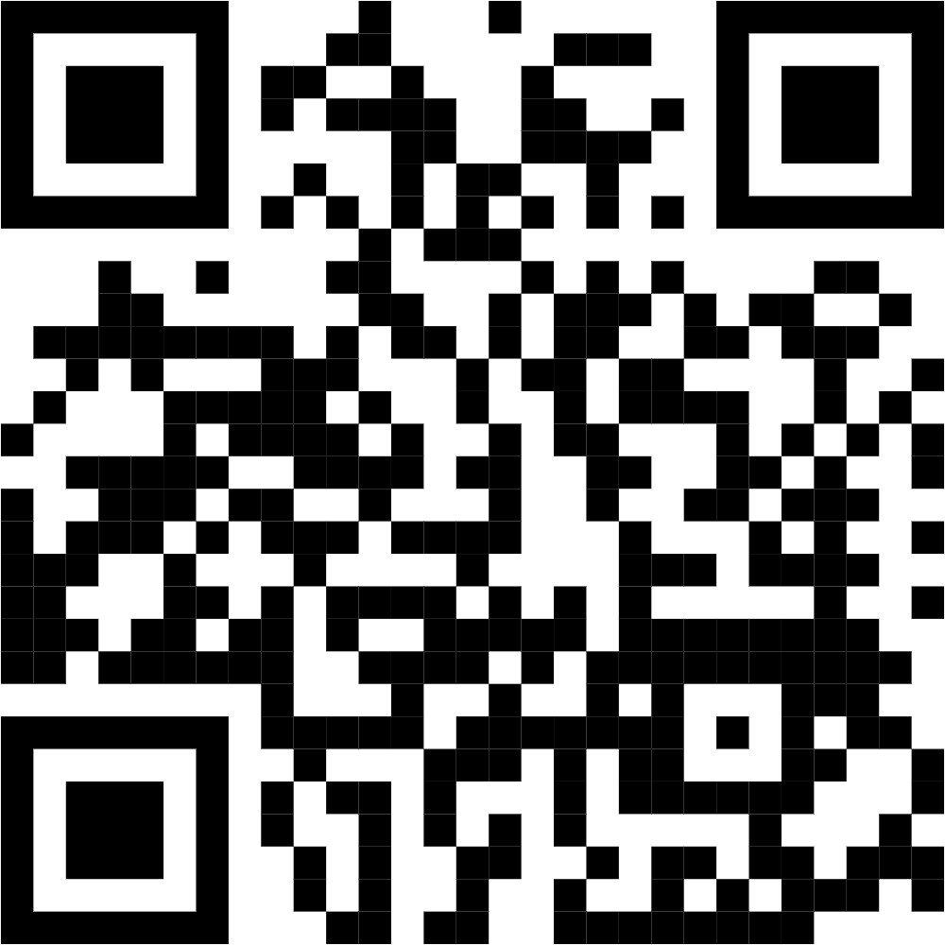





Slide 2
What we do?
Meetups
Network of Beginners, Professionals & Experts
Azure Cert Study Jam
CSR Activities

Slide 3
What is Spec-Driven Development?
Spec-Driven Development (SDD) is a development approach where you define requirements and behavior before writing code.
In GitHub Spec Kit, specs act as the source of truth for AI agents and developers.
It focuses on creating clear requirements, user stories, constraints, and acceptance criteria upfront.
AI tools then use these specs to generate implementation plans, tasks, and code more accurately.
SDD improves consistency, reduces ambiguity, and enables faster AI-assisted development.

Slide 4
Phase 1: Project Constitution Establish governing principles
using/speckit.constitution to guide all subsequent development.
Define code quality standards
Set testing requirement levels
Ensure user experience consistency
Establish performance baseline targets

Slide 5
Phase 2: Create the Spec
Use /speckit.specify to describe the What and Why without worrying about the technology stack.
Focus on user requirements
Define UI hierarchy logic
Establish data organization rules
Describe interaction flow behavior

Slide 6
Phase 3: Implementation Plan
The Contract The plan bridges high-level requirements and actual code generation.
Choose minimal library dependencies
Specify local-first data storage
Define deployment architecture constraints

Slide 7
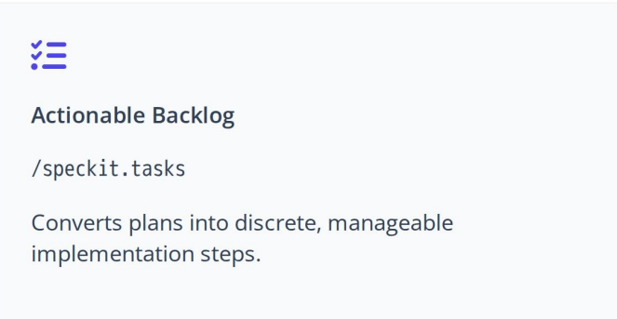
Phase 4: Break into Tasks

Slide 8
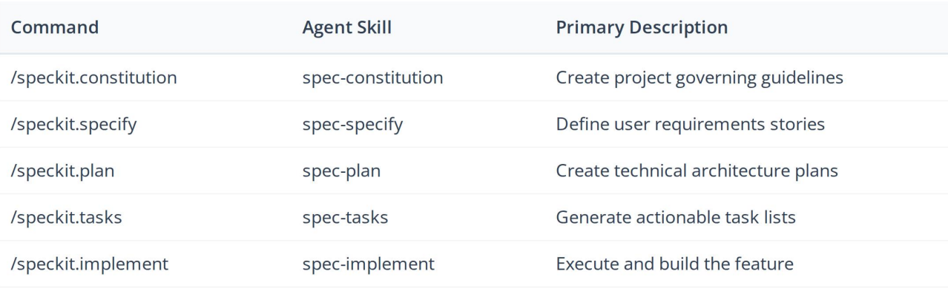
Core Toolkit Command Reference

Slide 9
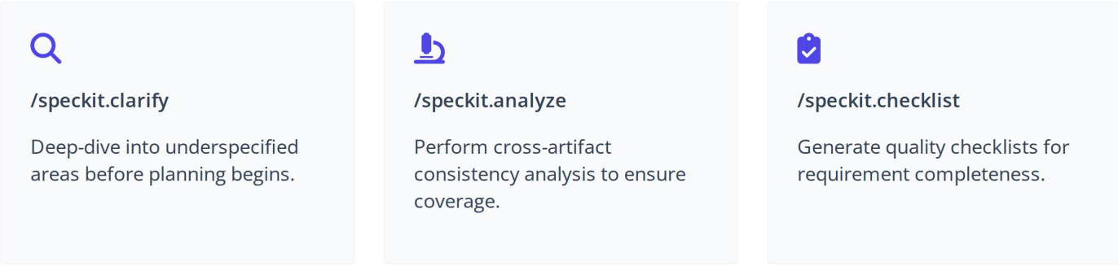
Advanced Validation Commands

Slide 10

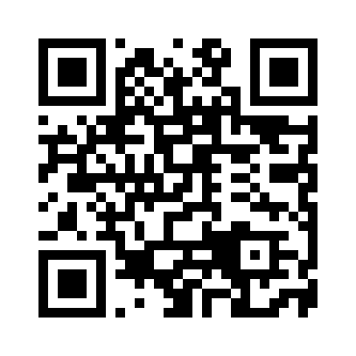
Connect with Me
Magesh Tamilselvan
www.linkedin.com/in/tmagesh

Slide 11
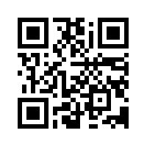
Open for Q&A
Presentation title
Thank you!!

